Slide 1
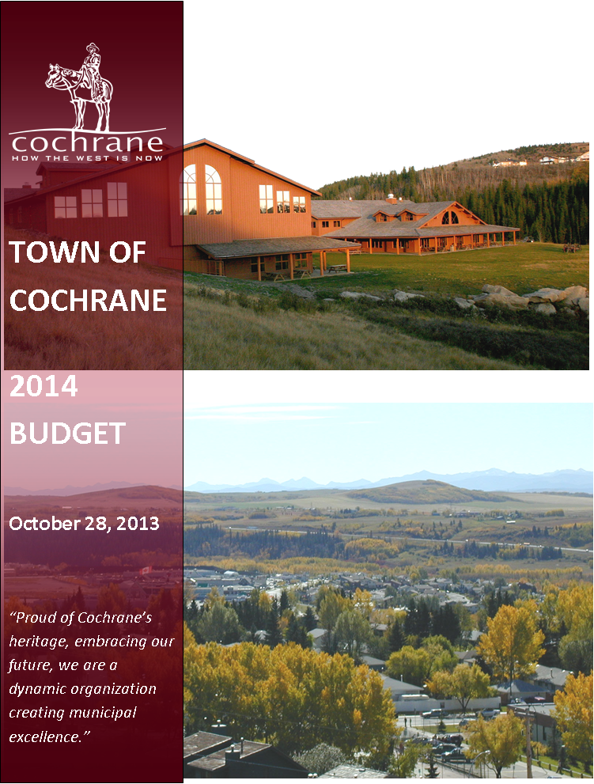
Draft

Slide 2
Agenda
Introduction, Strategic Plan
Budget Basics
Draft Budget Highlights
Workforce
Draft Operating & Capital Budgets
Property Tax Impacts
Grants
Conclusion

Slide 3
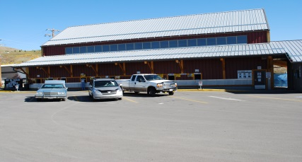
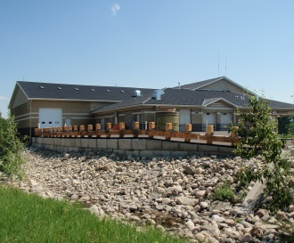
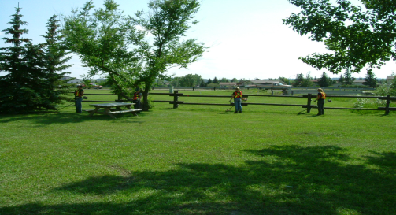
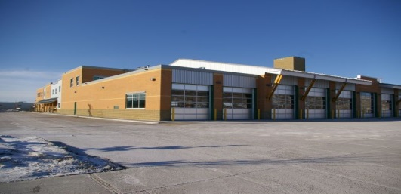
Introduction
Cochrane Sustainability Plan
Town of Cochrane Annual Strategic Plan
Council Priorities
Plans and Studies
Annual Business Plans
Annual Budget
Operations

Slide 4
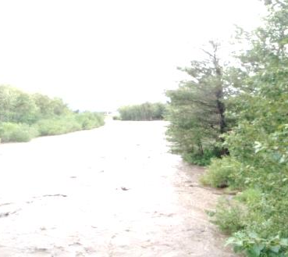
Cochrane Sustainability Plan
13 PATHWAYS TO THE FUTURE…
We Build a Culture of Responsibility
We are a socially responsible and empowered community.
We are Responsible Citizens of the Planet
We treat water as a precious resource.
We use energy responsibly and innovatively.
We contribute to the solution on climate change.
We Live Locally
We consume the bounty of our local economy.
Our local economy is healthy and diverse.
Everyone has an opportunity to pursue their potential in Cochrane.
We are a caring community that lives and celebrates together.

Slide 5
Cochrane Sustainability Plan
13 PATHWAYS TO THE FUTURE…
Cochrane is a Complete Community
Everyone has a roof over their head.
There’s enough room for everything a community should have.
Wherever you are in Cochrane, you’re close and connected.
There are diverse options for getting around.
We build Cochrane on the strengths of our natural and cultural heritage.

Slide 6
Strategic Plan and Budget Process
Update Strategic Plan and 10 year Financial Strategy
Council Approves Strategic Plan
Business Plans Created
Business Plans Approved
Budgets Prepared
Budget Administrative Review
BP’s reflect budget impacts
Budget Package presented
Review by Council & public
Council Approves Final budget
Mar/April
Dec 9
Oct/Nov
May
Oct 28
June
Sept/Oct
June/July

Slide 7
2014 Strategic Plan
Strategic Planning session held spring 2013
Updated Ten Year Financial Strategy
Identified Council’s 2014 top priorities:
    Aquatic Centre
    Economic Development
    Renewable Energy Framework

Slide 8
2014 Strategic Plan
Example Business Plan actions
to achieve Strategic Plan:
Implement Economic Development Strategy
Fundraising for Aquatic, Curling, Arts, and Outdoor Fields
Complete Riverfront Park
Complete Multimodal Transportation Plan

Slide 9
2014 Strategic Plan
Example Business Plan actions
to achieve Strategic Plan
  Design and construct new Police station
  Conduct a Community Survey
  Prepare Renewable Energy Framework
  Update Land Use Bylaw

Slide 10

Introduction
BUDGET BASICS
Assigns $$ for specific purposes
Funds Council priorities
Communicates how public funds will be spent

Slide 11
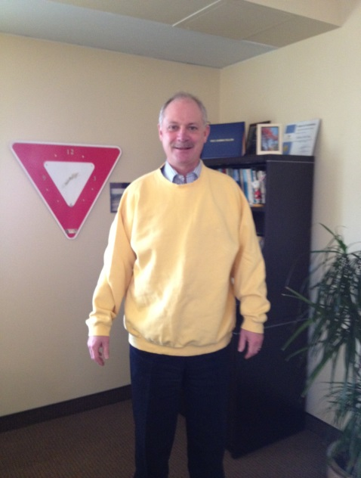
Introduction
MUNICIPAL OPERATING BUDGET
Pays for ongoing operations of the Town
  Salaries
  Contracted services
  Maintenance
  Supplies
  Debt servicing

Slide 12
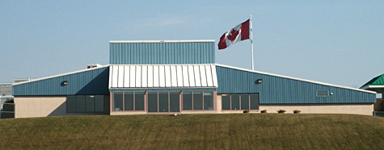
Introduction
MUNICIPAL CAPITAL BUDGET
Pays for physical assets (over $5,000)
  Equipment
  Fleet
  Town facilities
  Roads
  Parks
  Utility infrastructure

Slide 13

Introduction
Municipal Reserves
Saving for the future
  Operating reserves
  Capital reserves

Slide 14
Introduction
“FUND ACCOUNTING”
Operating
Capital
Reserves - restricted or unrestricted
Financial sustainability
Operating Reserves Policy 1705-01
Operating Reserves
Capital Reserves

Slide 15
Introduction
Operating Fund transfers
  Money to pay for capital projects
  Money for savings
  $5,000 to buy meters $5,000 meters cost
  $100 for future emergency
  $500 for future capital
Total $5,600 from operating fund
Operating Fund
Capital Fund
Reserve Funds

Slide 16
Introduction
Reserve Funds
Operating Fund
Operating Reserve
Save $100 for emergency Opening $1,000
  add in 2014 $100
                Ending $1,100
Save $500 for capital
  Opening $80,000
              add in 2014 $500
              Ending $80,500
Capital Reserve

Slide 17
2014 Draft Budget Highlights
$39.9M in total expenditures
$20.9M in offsetting revenues
$19M net cost of operations ($18M in 2013)
5.5% shift in net cost of operations over 2013
Notes:
16

Slide 18
Draft Budget Highlights
Total tax increase proposed is 1.49%

Slide 19
Draft Budget Highlights
Net cost of fire service increased by 4% growth
0% Fire Tax increase

Slide 20
Draft Budget Highlights
Net cost of municipal services excluding Fire increased by 4% growth
2% Tax increase

Slide 21
Draft Budget Highlights
Budget balanced by…
Cost containment
Growth revenues
Deferral of lower priority capital and operating projects

Slide 22
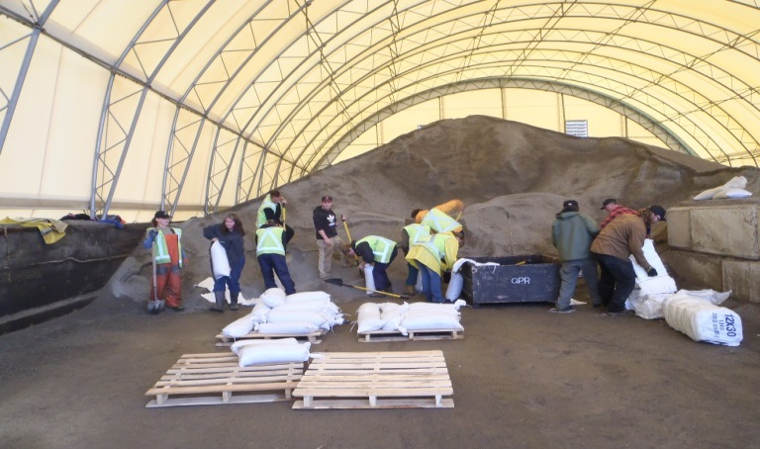
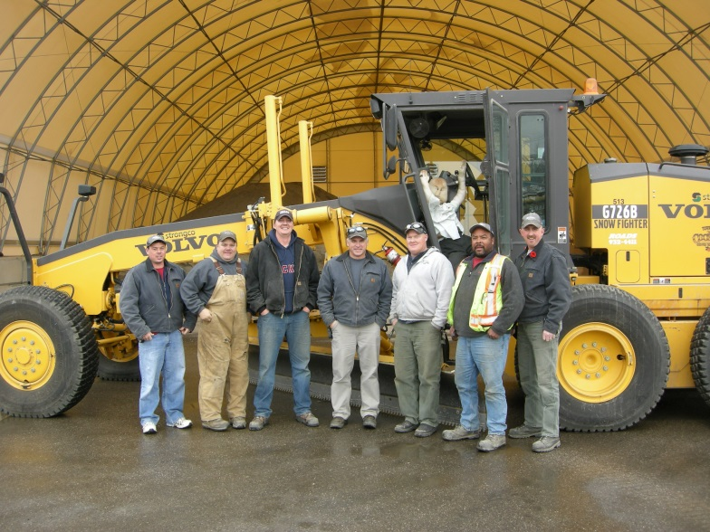

Workforce
Our workforce consists of a total of 298 employees employed in
  149 full-time, perm. part-time positions
  149 casual and seasonal positions
Notes:
Ms Milner referenced operating budgets and I will speak to the staffing portion of our operating budget.
Our workforce is comprised of 149 full-time and permanent part-time positions with the same number in seasonal and casual positions

Slide 23
Workforce
Process for staffing:
Staffing requests submitted through budget cycle
Reviewed by SLT
Recommendations brought to Council on a priority basis
Notes:
Staffing requests are submitted by Managers for growth in areas, additional hours, change in positions or new areas of focus. HR coordinates these and reviews with SLT

Slide 24
Workforce
192.35 FTE for 2014
FTE = Full Time Equivalent
    Is a unit of measure which is equal to one full time position
Increase of 6.5 FTE from 2013
  Includes 3 FTE to change from contracted to in-house assessment services
Notes:
As majority of our people are casual, seasonal and part-time we tend to measure all of the positions as equivalent or relative to the quantity of full-time positions that would be required.
In 2014 we will have just under 193 FTE’s if Council approves the 6.5FTE’s requested in the budget which includes the three assessment positions that were previously presented to Council (at the time) to move from contracted to in-house assessment services

Slide 25
Workforce
Year to Year
$16.8 million in 2014
$16.1 million in 2013
Staff as a % of Operating Expenses
2014 = 42%
2013 = 43%
Notes:
$16.8 million is the total costs of wages and benefits and is inclusive of the new positions and any annual increases proposed
Our staffing costs remain at a fairly consistent percentage of our total operating budget in the low 40’s ADD IN MUNICIPAL COMPARATORS INFORMATION

Slide 26
Workforce
Significant developments:
Ratification and implementation of the Collective Agreement which expires June 30, 2014
Compensation review completed
Employee Survey conducted
Recruited for 48 staff positions year-to-date
Notes:
Significant developments in our workforce budget this year have included ratification of the CA; a compensation review conducted this year that develops our budget for the 2014 year; an employee survey was conducted and is in the process of being rolled out to staff and the Town has recruited for 48 staff positions so far this year with election, census workers and committee members and volunteers in addition to that

Slide 27
Workforce
Emerging themes in employment:
Increase in retirements anticipated in all industries
Pension reform (pension deferral) to accommodate increased retirements
Employers raising concerns about retention
Notes:
Looking outward at broader employment themes we see that (slide) At the Town we have a slight increase in retirements starting now with about 3/yr anticipated in the next couple of years; as we know with the increased retirements and baby boomers moving through the system pension reform is being addressed to accommodate the increased access and address pension sustainability. Cochrane is fortunate to not have attraction and retention concerns as themes here as we typically experience strong response to job postings and have a significant number of long-term staff. Our 2013 YTD turnover rate is about 6%, low and lower than comparable municipalities in the area. ADD IN PERCENTAGE OF STAFF NEARING RETIREMENT AGE 55+

Slide 28
Workforce
Our Total Rewards
Wage rates at or above median for all eligible staff in relation to Council approved, comparative Alberta municipalities.
A broad total compensation approach comprised of base, vacation, general holiday and premium pays and for eligible employees long-term security via a defined benefit pension plan.
Supporting quality of life and enabling us and our families to be healthy through provisions for wellness and group benefits, generous leaves.
Team and individual accountability and opportunities through on-going coaching and support.
A safe and respectful workplace based on trust.
Challenging work
The Cochrane Community
Notes:
A peek at our Total Rewards Philosophy: Total rewards package based on competitive wages, vacation, holidays, defined benefit pension plan, group benefits, leaves and training and development opportunities.

Slide 29
Workforce
Determinants for Compensation:
Bi-annual review
Seek comparable data from 10 Council-approved similar municipalities
Job evaluation committee reviews positions and rates internally
Compensation trends and inflation rates monitored
Notes:
Compilation of internal ranking and external market data presented to senior leadership for final grid development. Trends monitored with external markets, other municipal indicators and industry best practices. This year our compensation review reflected the steadying of the market and showed Cochrane wages overall as quite close to the current comparative market

Slide 30
Workforce
CAN - average raise in base pay expected to rise 3.1 per cent (Mercer)
AB - average salary increase of 3.2 per cent next year, driven by the oil and gas industry (Hay Group)
CGY - about a 3.5 % increase in pay. Well below projected increases of 3.7% before the 2008-09 economic downturn (Hay Group)
Overall year-to-year trend is stable
AB Unemployment rate at 4.6%
Notes:
As you can see from the trends unemployment rates in Alberta remain low as provincially we continue to compete for talent.
Rate increases for Alberta employees are becoming more stable with more moderation trending in the public sector. Calgary area remains higher than many other areas in Canada but overall these anticipated increases are very comparable to last year and we are starting to see employment market stability with increases much lower than those before the ’08/09 downturn

Slide 31
Workforce
Benchmarks:
CPI = Consumer Price Index
Modest CPI growth through 2013
  August CPI
        Calgary 1.7%
        Alberta 1.4%
        Canada 1.1%
COLA = Cost of Living Adjustment
Comparator municipalities indicating
  COLA adjustments of (1-3%) plus merit & market adjustments
Notes:
Consumer Price Index is a measure of the total cost of basket of goods through which statistics Canada determines rate of inflation for given jurisdiction. Historically we have used the August CPI indicator for Calgary as our measure for cost of living adjustments to be applied. our comparator muni’s are applying COLA in the 1-3% with market and merit increases additional to that.

Slide 32
Workforce
Included in the budget:
  Out of scope staff – recommendation of 1.7% COLA, applicable market adjustments & step increments for performance and service for eligible staff
  In-scope staff - 2% for January 1 to June 30, 2014 per the collective agreement
Notes:
Approx. 40% of staff will experience a market adjustment as a result of our market review. Back pocket: Across our permanent positions the average increase inclusive of COLA, steps and market adjustment is 4.5% combined
Pass over to Ms Milner to speak to other areas of the operating budget

Slide 33
2014 Draft Operating Budget
Property tax revenue is 48% of total revenue
Assumed 4% growth rate for new tax revenue of $723,000
Proposed 1.49% property tax increase for additional tax revenue of $269,000

Slide 34
2014 Draft Operating Budget
User fee/fines/permits revenue is 35% of total revenue
Proposed user fee increases
Building permit revenue at record levels

Slide 35
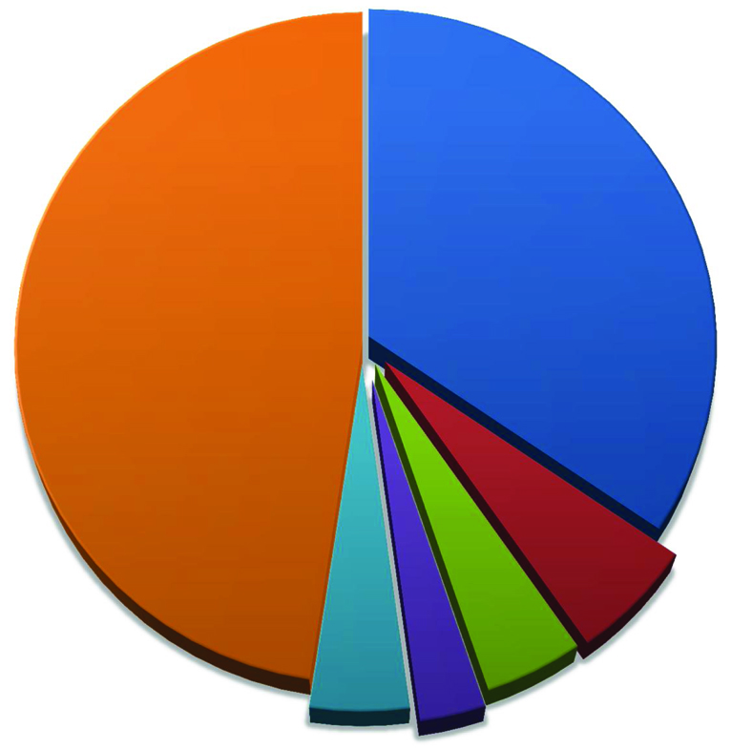
Draft Operating Budget
2014 Total Operating Revenues $39.9 million
Your municipal tax dollars
48%
User fees/rentals/permits
35%
Government contributions
Fines, penalties, other
revenue
Utility Return on Investment
Franchise fees
6%
4%
4%
3%

Slide 36
Draft Operating Budget
Expenditure Highlights…
Total Operating Expenditures up 7% to $39.9M ($37.2M in 2013)
$16.8 million total staffing costs ($16.1M in 2013)
Explanations for increases are included throughout the budget document in each service area
  Increased staffing municipal enforcement
  Increased grants

Slide 37
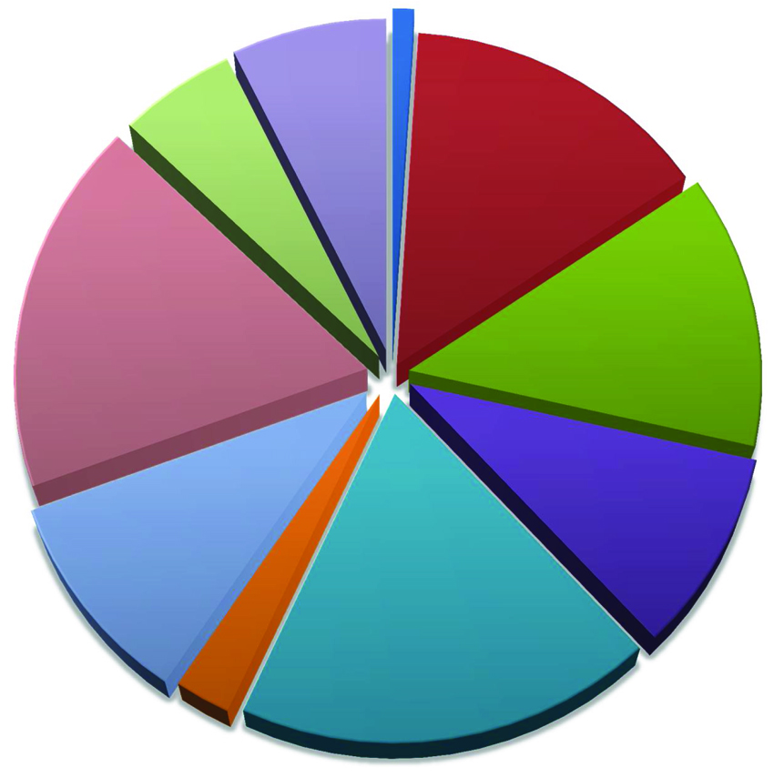
Draft Operating Budget
2014 Total Operating Expenditures $39.9 million
Planning, Engineering & Economic Development, 2.9, 7%
Council, 0.4, 1%
2.2, 5%
Waste & Recycling,
General Government
& Corporate Services,
5.8, 15%
Waste &
Wastewater, 7.1
18%
Fire Services, 5.2, 13%
Police and Municipal Enforcement,
Roads & Storm
Sewer, 4.0, 10%
3.8,10%
Community Services, Town Facilities, Recreation & Culture, Cemeteries, Parks, FCSS, 7.5, 19%
Community Grants
& Library, 1.0, 2%

Slide 38
Draft Operating Budget
Expenditure Highlights…
Fixed costs
  Power budget up 8%
  Maintenance contracts up 10%
  Insurance up 10%
  City of Calgary sewer charges increase 13.5%
  City of Calgary landfill tipping fees increase 4.1%

Slide 39
Community Grants & Library
Community Grants and Library proposed increase of $95,600 or 11%
$343,000 for annual Operating Grants to Organizations ($378,000 requested)
$35,000 for one-time capital grant Spray Lakes Recreation Society ($105,000 requested)
$25,000 for Community Grant Program (explain what this grant is)
includes $20,000 for painting and flooring to maintain the facility

Slide 40
Property Tax Impacts
Many tax rates make up the annual tax bill
      Municipal
      Requisitions – Education & Rocky View Foundation
Town only controls municipal portion of tax bill/rates
65% of tax bill stays within Municipality and balance goes to various requisitions

Slide 41
Property Tax Impacts
Assessment values confirmed January 2014
Tax rates adjusted annually to ensure municipality stays in revenue neutral position from year to year
Education requisitions known late April 2014
Tax rates finalized and presented to Council in May 2014 for approval

Slide 42
Property Tax Impacts
1.49% municipal property tax increase
=
$2.63 per month for the average single family dwelling assessment
$2,146 average municipal tax bill

Slide 43
Draft Capital Budget
$15.7M Total 2014 Capital Budget
$14.3M 2014 Capital projects
$1.6M from operations to capital budget

Slide 44
Draft Capital Budget
$135,000 in projects are funded from operations and the rest from grants, debt, and reserves
Capital spending reduction minimal impact on the 2014 tax rate
$1.4M to capital reserves in 2014
Total 2014 reserve contributions are 3.6% of total operating expenditures
  Ten year financial strategy target is 4%

Slide 45
Draft Capital Budget
$14.3M 2014 Capital projects
Key infrastructure projects:
Police Station | $ 8.0
Booster Station upgrades | $ 2.0
East End Road Improvements Sibbald St and Pope Ave | $ 1.7
RancheHouse Rd Access | $ 0.4
Highway 1A/Centre lights | $ 0.3
Second Bow River Bridge crossing engineering work | $ 0.3
Roads - Bucket truck | $ 0.2
 | $ 12.9
Minor Capital Projects | $ 1.4
Total Capital Projects | $ 14.3

Slide 46
Debt Limit
Debt end of 2014 - $20.8M ($13.6M end 2013) with $8M for new Police station
Police debt repayment start in 2015
2015 Operating Budget impact
  Annual repayments est $680,000/year
  $330,000 lease revenue in 2015
  $350,000 net increase in 2015 costs

Slide 47
Debt Limit
Max legislated (MGA) debt - $53M
Council debt max: not to exceed 80% of this, or $42M
The Town is projected to be at $20.8M or 49% of its Council debt limit at the end of 2014.

Slide 48
Grants
PROVINCIAL CAPITAL GRANTS

Slide 49
Provincial Capital Grants
1. ALBERTA MUNICIPAL SUSTAINABILITY PROGRAM (MSI)
  The Province committed $42M 10 years (2007 to 2016).
  $17M received to 2013
  Annual capital grants can be saved for one large project provided it is completed within five years

Slide 50
Provincial Capital Grants
MSI Capital 2014
  $3,500,000 estimate
  Designate for future construction costs of Aquatic Facility

Slide 51
Provincial Operating Grants
MSI Operating 2014
  $166,000 estimate
  Planning projects a priority for Operating grant
  MSI Operating ends in 2015

Slide 52
Grants
2. PROVINCIAL BASIC MUNICIPAL TRANSPORTATION GRANT (BMTG)
  2013 BMTG $1,055,000
  East End improvements

Slide 53
Federal Capital Grant
FEDERAL CAPITAL GRANT
$3,438,320 in Federal New Deal grants for 2010 to 2014 approved.
$859,580 New Deal 2014 required for
  RancheHouse Road Access
  downtown stormwater upgrades
  River Heights storm valve
  sidewalk infrastructure repairs

Slide 54
Public Engagement
Town Website – October 29
Budget summary published in the Cochrane Times - November 6, 2013
Budget Open House - November 18, 2013
6pm – 8pm
Feedback mechanisms provided

Slide 55
What’s Next
Process for Budget Questions
Council debates budget at Special Meetings on Nov 23, 25, and 26, 2013
Budget changes made and final budget prepared for Dec 9 Council meeting
Council approval of 2014 Budget

Slide 56
Conclusion
Administration recommends that…
Council receive the Draft 2014 Operating and Capital Budgets as information;
and
Schedule a Special Meeting November 23; 25 & 26, 2013 to deliberate the 2014 budget.

